Slide 1
Farm (DTC) Marketing 101

Slide 2
Peter Drucker
Business Consulting Legend
“Because the purpose of business is to create a customer, the business enterprise has two– and only two–basic functions: marketing and innovation. Marketing and innovation produce results; all the rest are costs. Marketing is the distinguishing, unique function of the business.”

Slide 3
Take Home Points
Understanding your Audience
Elements of Brand Equity
The Local Marketing Toolbox
Parting Thoughts

Slide 4
Audience
essential to effective communications
How?
How do you reach them? .
Who?
Who is your audience?
Why?
Why do they care?

Slide 5
Research + Strategy
Both are a great place to start, but they never stop evolving
ADAPT
Understanding experiments and research is critical to adapting your marketing strategy to meet your goals
The key to good research and strategy is answering these questions:
Who? Why? What? When? Where?

Slide 6
The 5 P’s of Marketing
Product
The value you create for your customer.
Promotion
Price
What is your value worth?
Price
Place
Promotion
How aware are people of your value?
Place
Where and How is your value consumed?
Product
Packaging
Packaging
Added value for functionality
and brand perception

Slide 7
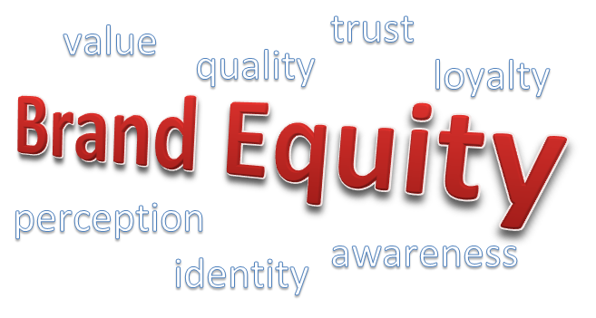

Slide 8
What is Brand Equity?
When the customer has a high level of awareness of and familiarity with the brand and holds strong, favorable, and unique associations with it, this is known as “Brand Equity”.
Driven by “brand knowledge” – brand awareness and brand image.
Difficult for competition to match

Slide 9
Elements of Brand Equity
Brand Identity
Brand Loyalty
Perceived Quality
Brand awareness
Brand Equity
Brand Association

Slide 10
Brand association is anything which is deep seated in customer's mind about the brand. Brand should be associated with something positive so that the customers relate your brand to being positive.
Brand Awareness is the extent to which consumers are familiar with the distinctive qualities or image of a particular brand of goods or services
Brand identity is the message the consumer receives from the product, person, or thing. Should be a consistent message.
Brand loyalty is the tendency of some consumers to continue buying the same brand of goods rather than competing brands
Perceived quality is the customer's perception of the overall quality or superiority of a product or service with respect to its intended purpose, relative to alternatives.

Slide 11
Tools to Capture Brand Equity

Slide 12
The Local Marketing Toolbox
10
Email Marketing
It’s still alive and well. Targeted lists are key to success.
Target Marketing
Directing your focus, demographics.
E
T
Social Media
It’s the distribution engine for connecting with your audience.
Web design
Your website is your storefront in 2016. Design & functionality matter.
S
W
Content Marketing
Blogging, videos, downloads, etc. drive the internetand engagement
Graphic Design
Often overlooked…your brand, your image excite people.
C
G

Slide 13
Email Marketing
E
Most preferred medium for news and promotions
Easily Measured with Platforms like MailChimp or Campaign Monitor
Email is customizable and mobile

Slide 14
Social Media
S
It’s been the buzz in marketing since its existence…
It’s been misunderstood as the solution to all your marketing problems.
If you don’t do it right then you are wasting time and you may be harming your brand

Slide 15
LinkedIn
Professional Networking with Local Influencers
Twitter
Build a local, niche audience. Learn from others in local food across the country
Facebook
The largest audience and the most important social platform for local business marketing
Pinterest
Largest platform in food
YouTube
Video is the most engaging content on the internet

Slide 16
Web Design
W
Your website is now your first impression to the world
Trends:
Full-Width
Parallax
MOBILE OPTIMIZED
Do It Yourself Sites (Hosted):
Squarespace
Wix
E-Commerce (Hosted):
Shopify

Slide 17
Graphic Design
G
Simple and Clean Design
Contractor Marketplaces:
Fiverr
Upwork
Photography is Critical
High-resolution images grab attention
Local = Authentic

Slide 18
Content Marketing “Storytelling”
C
Most important part of marketing for small and growing businesses
Types:
Videos
Blogs
Product Downloads
Coupons/Promotions
Webinars
Excite your audience, incentivize them, engage them in the conversation

Slide 19
Target Market
f
Targeting is crucial for connecting with the right audience.
Experiment with Facebook and Twitter Ads to learn more about the demographics in your area and how they respond to messages

Slide 20
Parting thoughts………
Happy customers are the most important key to success. They will return, and they will tell their friends about your operation. Learn their names. Remember what they like and have it ready for them. Keep a database if you can't keep it all in your head. The little touches make all the differences.
Develop a mailing list. Get names from outdoor magazines, associations, and other sources of people that like outdoor activities. Your mailing list is your most important asset. Mail to your customers at least twice a year.
People don't come to hunt or fish or ride a horse or tractor. They come to have fun and relax! You are in the hospitality business; take care of your customers and you will succeed. Always ask your customers what they liked about their stay and what could be improved.
Produce quality brochures and PR materials. On brochures, less is more. Don't clutter it with lots of words. Use photos. Hire a graphic artist or get lots of feedback from other business people before you go to print. Don't use a photocopier. Color is costlier than a black and white brochure, but it shows a commitment to quality and attracts a lot more attention.

Slide 21
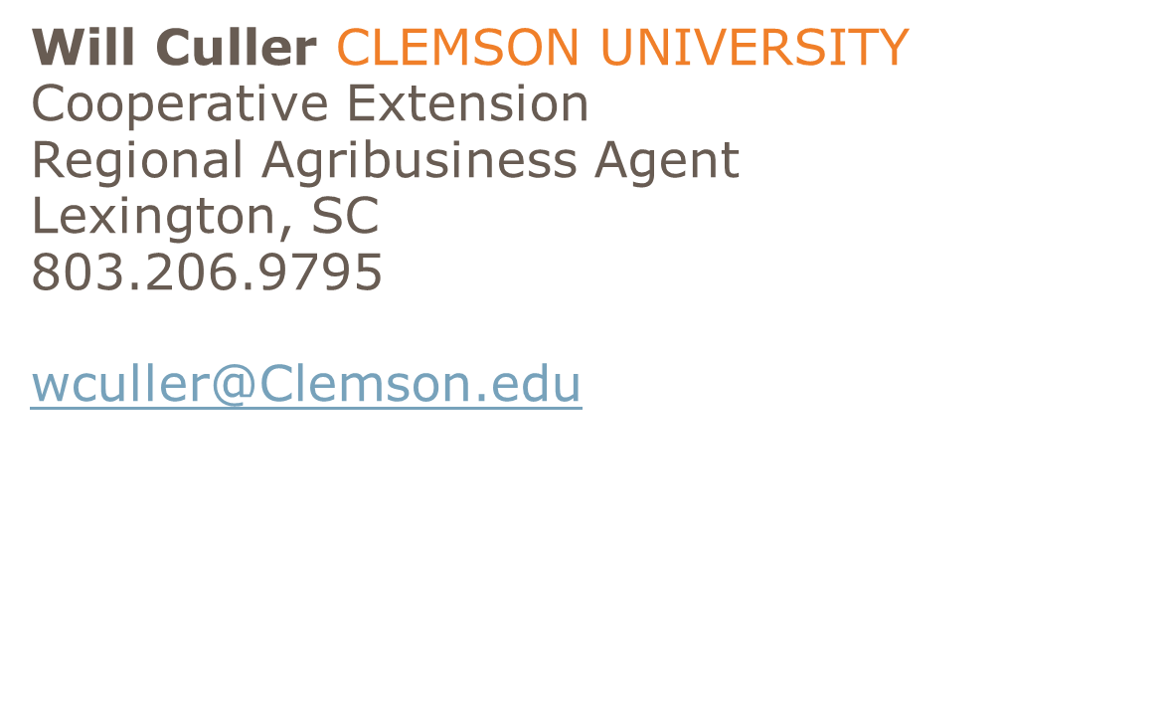
Questions?

